Slide 1
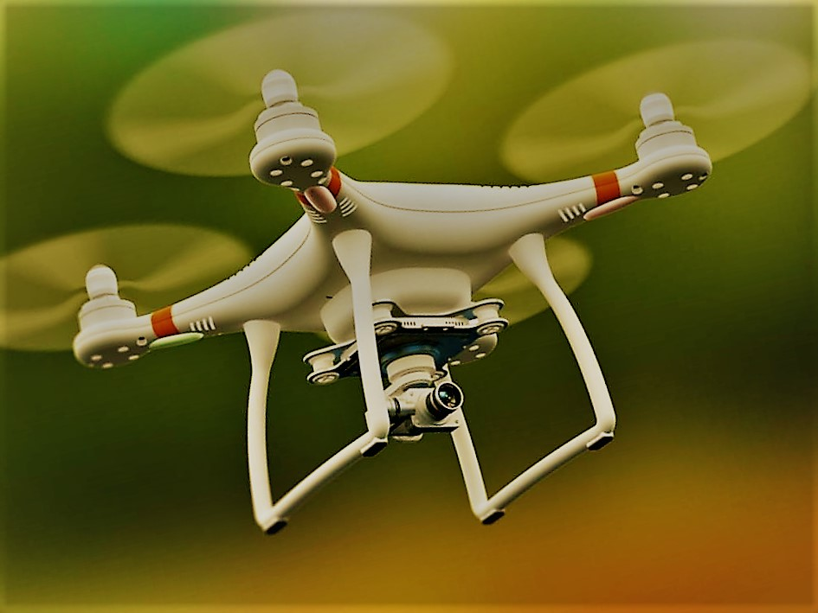
MULTI PURPOSE QUADCOPTER

Slide 2



Contents:
Introduction
Literature Survey
Project Proposal

Slide 3
INTRODUCTION

Slide 4
We intend to make a quadcopter installed with a camera on it which would help us provide relief services during disaster management and could act as a very efficient part of the defense artillery. This quadcopter would be equipped with computer vision algorithms which would instill in it the ability to detect the coordinates of humans and ensure proper allocation of resources.

Slide 5
Chart

Slide 6
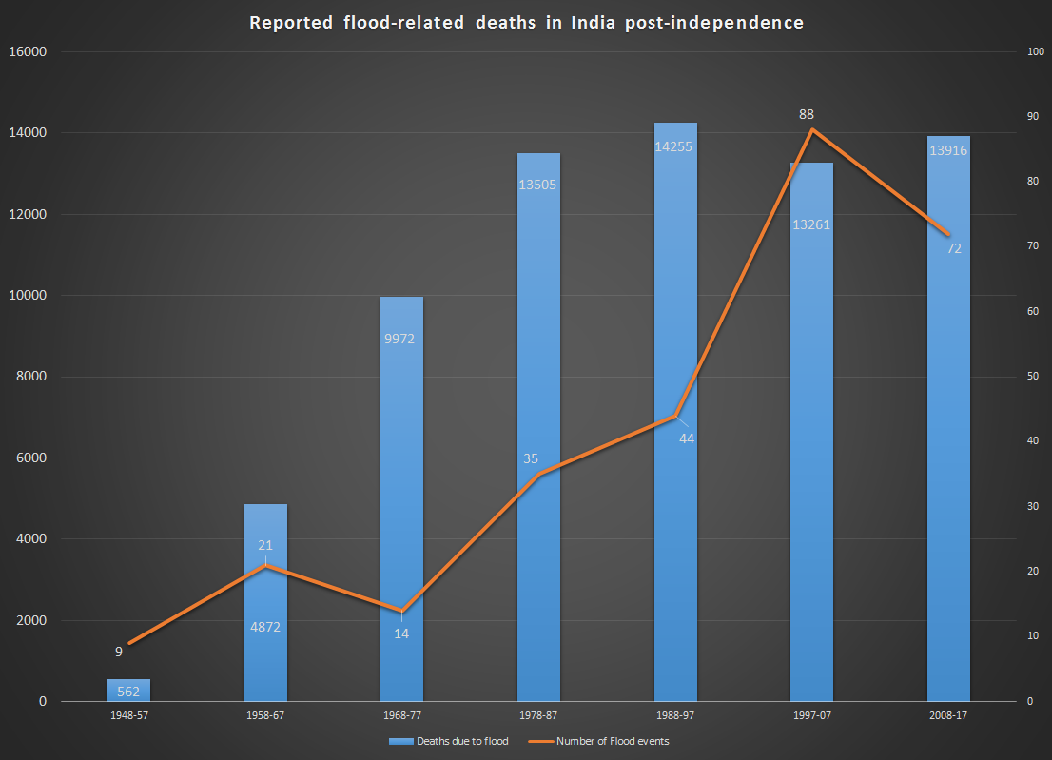
Chart

Slide 7
Literature Survey

Slide 8
UAV PHOTOGRAMMETRIC SOLUTION USING A RASPBERRY PI CAMERA MODULE AND SMART DEVICES: TEST AND RESULTS
By Marco Piras
Nowadays, smart technologies are an important part of our action and life, both in indoor and outdoor environment. There are several smart devices very friendly to be setting, where they can be integrated and embedded with other sensors, having a very low cost. Raspberry allows to install an internal camera called Raspberry Pi Camera Module, both in RGB band and NIR band. The advantage of this system is the limited cost ( This paper will describe a research where a Raspberry Pi with the Camera Module was installed onto a UAV hexacopter based on arducopter system, with purpose to collect pictures for photogrammetry issue. Firstly, the system was tested with aim to verify the performance of RPi camera in terms of frame per second/resolution and the power requirement. Moreover, a GNSS receiver Ublox M8T was installed and connected to the Raspberry platform in order to collect real time position and the raw data, for data processing and to define the time reference. IMU was also tested to see the impact of UAV rotors noise on different sensors like accelerometer, Gyroscope and Magnetometer. A comparison of the achieved results (accuracy) on some check points of the point clouds obtained by the camera will be reported as well in order to analyse in deeper the main discrepancy on the generated point cloud and the potentiality of these proposed approach. In this contribute, the assembling of the system is described, in particular the dataset acquired and the results carried out will be analyzed.

Slide 9
Survey on Computer Vision for UAVs: Current Developments and Trends- by Christoforos Kanellakis
During last decade the scientific research on Unmanned Aerial Vehicles (UAVs) increased spectacularly and led to the design of multiple types of aerial platforms. The major challenge today is the development of autonomously operating aerial agents capable of completing missions independently of human interaction. To this extent, visual sensing techniques have been integrated in the control pipeline of the UAVs in order to enhance their navigation and guidance skills. The aim of this article is to present a comprehensive literature review on vision based applications for UAVs focusing mainly on current developments and trends. These applications are sorted in different categories according to the research topics among various research groups. More specifically vision based position-attitude control, pose estimation and mapping, obstacle detection as well as target tracking are the identified components towards autonomous agents. Aerial platforms could reach greater level of autonomy by integrating all these technologies onboard. Additionally, throughout this article the concept of fusion multiple sensors is highlighted, while an overview on the challenges addressed and future trends in autonomous agent development will be also provided

Slide 10
PROJECT PROPOSAL

Slide 11

OBJECTIVES
To ensure allocation of resources to every victim during disaster management.
Could act as a surveillance quadcopter.
It will be equipped with a night vision camera for night surveillance.
Further modifications could be made to turn it into a military based quadcopter.

Slide 12
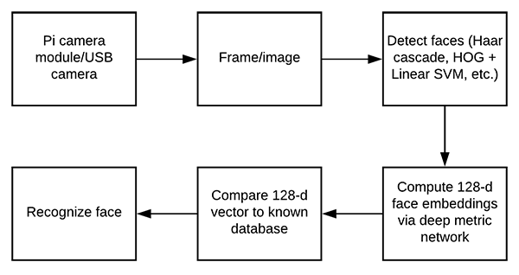
BLOCK DIAGRAM FOR IMAGE RECOGNITION

Slide 13

FUTURE SCOPE
A quadcopter equipped with GPS technology
To be used as a payload in relief measures
To be made as an autonomous quadcopter

Slide 14
THE CAMERA SEES MORE THAN THE EYE, SO WHY NOT MAKE USE OF IT? - EDWARD WESTON

Slide 15
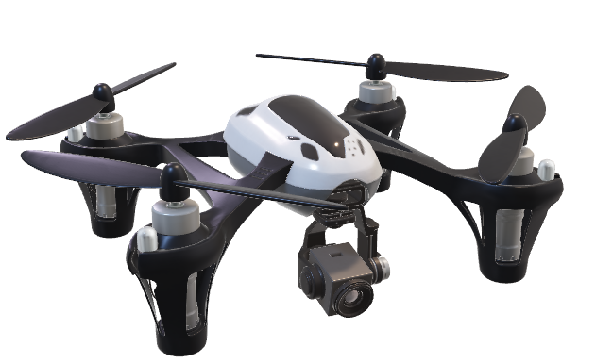
Thank You

